Slide 1
E-safety Awareness
for
Parents and Carers

Slide 2
Aims of the presentation?
Positive aspects of being online
Social Networking
Managing Risks
Child Exploitation and Online Protection Centre (CEOP)
Technologies your children might use –Gaming, Instant Messaging, Mobiles etc
Parental Controls
Tips for protection
Advice and help (including useful websites)

Slide 3
Why are we here?
•The next picture shows the speed at which the internet is changing the world.
•The sites you see are becoming overwhelmingly popular for both adults and children.
•The online world is increasingly integrated into our daily lives.

Slide 4
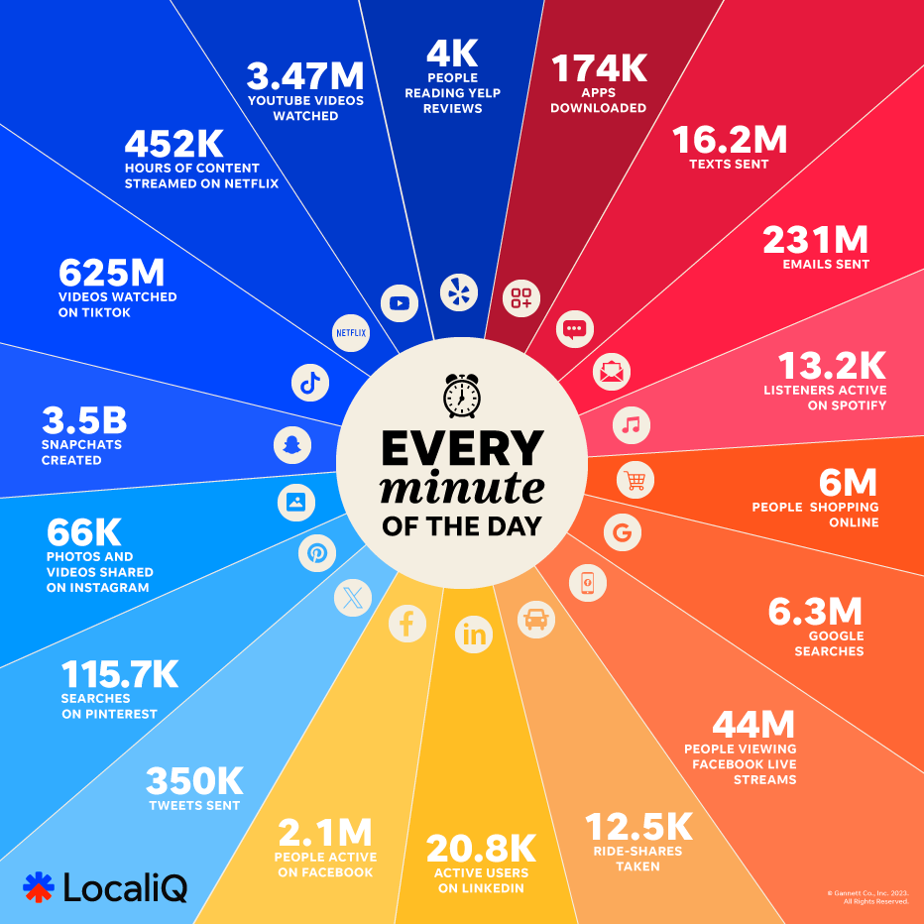
2023
Version

Slide 5
Websites
Which sites do your children use online?

Slide 6
The online world
•Children are natives in the online world, most are unaware of life without:
– Smartphones
– Games consoles
– Google
– Email
– Facebook
- Instagram/Snapchat/Tiktok etc…
•They feel confident using new sites, apps and technologies, moving from one to another with ease.

Slide 7
The Online World
There are many positive aspects of being online.
• Have a think about what your children are learning whilst they are online, whether socialising, gaming or doing homework?

Slide 8


Slide 9
Social Media
“ Today, social media is all around us; making it simpler to communicate and make contacts, opening doors to new exciting opportunities for creativity and education.”
CEOP 2011

Slide 10
Social Networking
Social networking has exploded into our lives, with many of us feeling pressure to join in or miss out.
Examples of social media/networking include: Facebook, Twitter, Youtube, Whatsapp, Instagram, Snapchat, Twitch, TikTok
These sites/apps allow us to connect with friends and communicate in ways 20 years ago we never dreamed would be possible.

Slide 11
Networking Apps
Who here has a Facebook, Twitter, Instagram, Tiktok profile?
Have any of you been pestered by your child to let them have a social media account?
Does anyone know how old you have to be to sign up for the majority of these accounts?
Are any of you friends with your children on their apps?

Slide 12
Security Tips
Security settings need to be set to “Private”, “Friends only” or the equivalent option.
They should only post content and photos they wouldn't mind showing you!
3. Try your very best to be “Friends” with your child on their accounts
4. Ask them to show you how the app works and what they can do on it.
5. Learn how to report an issue directly via the app

Slide 13
Security Tips
Help them set up their profile
Add your email as the main contact (if possible)
Ensure they only accept invites/add friends who are children they and you know
‘’ Bookmark” the CEOP webpage – more CEOP details to come later
Check in and keep updated with your child, if you have any questions which relate directly to a particular app, check the individual app help or support pages.

Slide 14
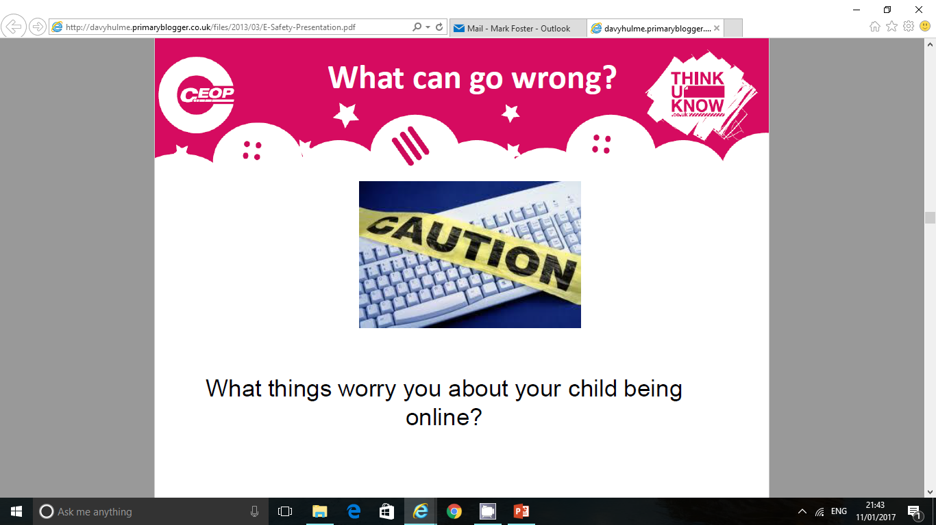

Slide 15
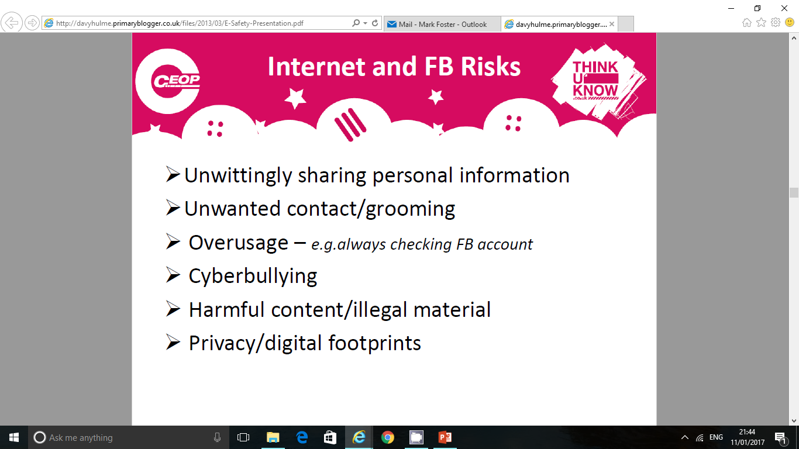
Online Risks
Unwittingly sharing personal information
Uninvited or Unwanted contact / Grooming
Overuse – potentially becoming addicted
Cyberbullying
Viewing harmful or illegal content
Lack of privacy / leaving a digital footprint

Slide 16
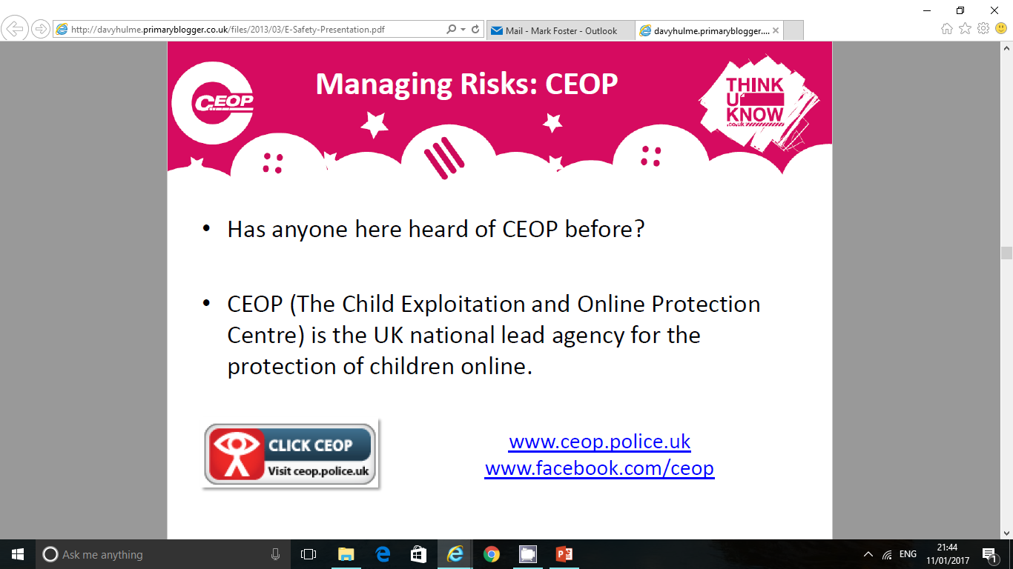
www.ceop.police.uk
www.facebook.com/ceop

Slide 17
CEOP
CEOP was set up in 2006. They have been working hard to protect children from harm online.
They work with safeguarding and child protection partners across the UK and overseas
In October 2013 CEOP was absorbed into the National Crime Agency
The website gives information on how CEOP can help, what happens when you make a report and allows children and adults to report inappropriate interactions and content directly to CEOP
There is a link to childline for information if a child is being bullied online
There are also many sources of information split into age groups for children, for parents/carers and professionals.
www.ceop.police.uk

Slide 18
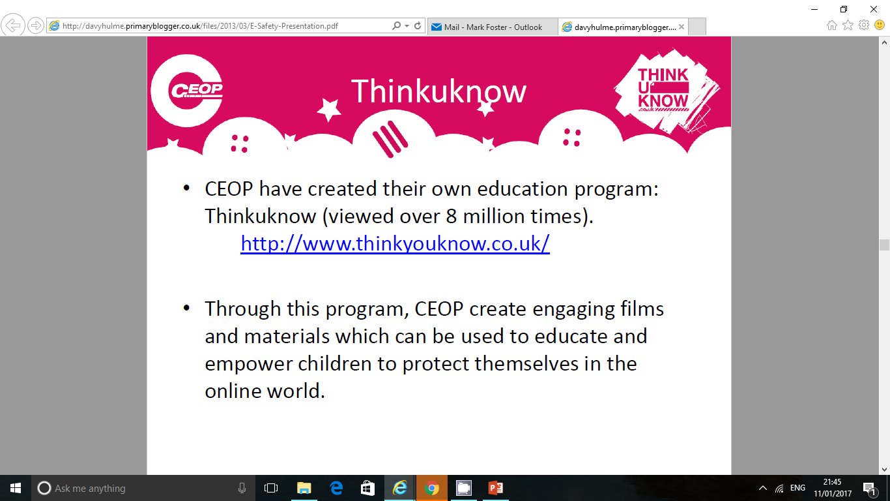
www.thinkuknow.co.uk/parents

Slide 19
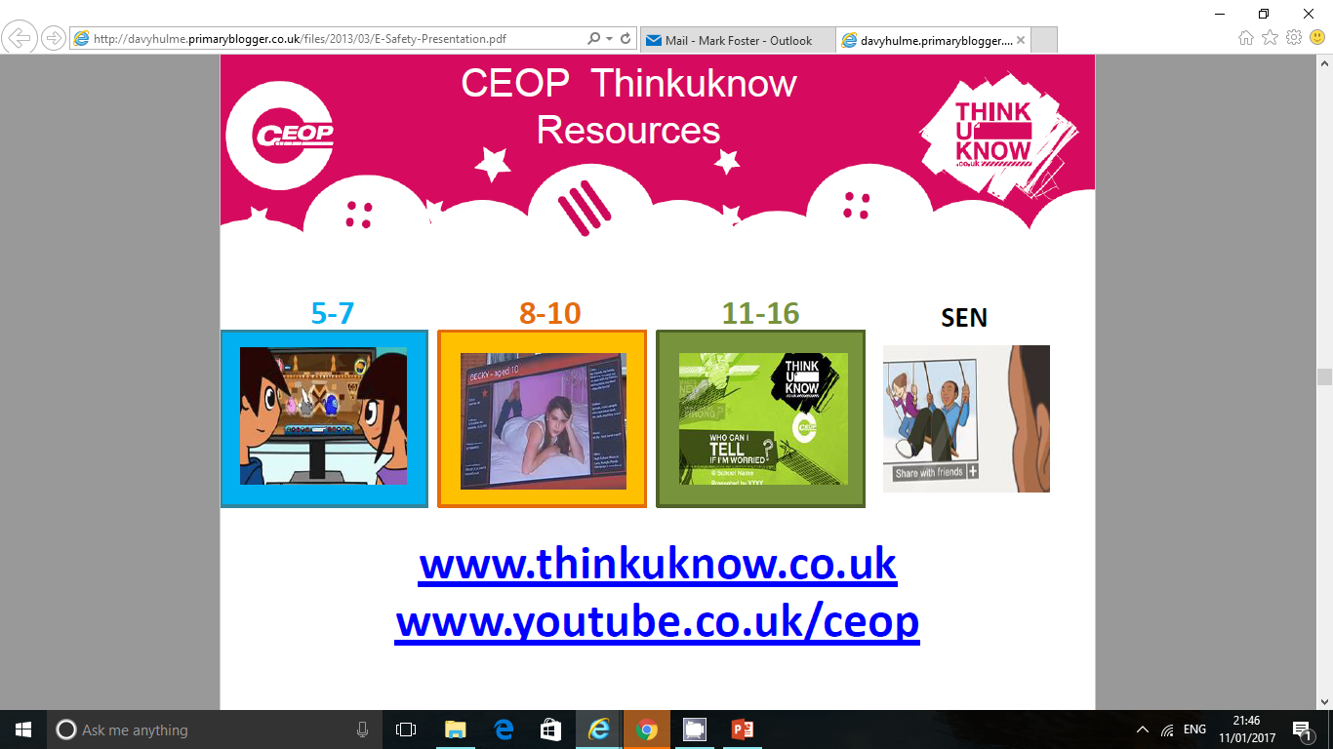

Slide 20
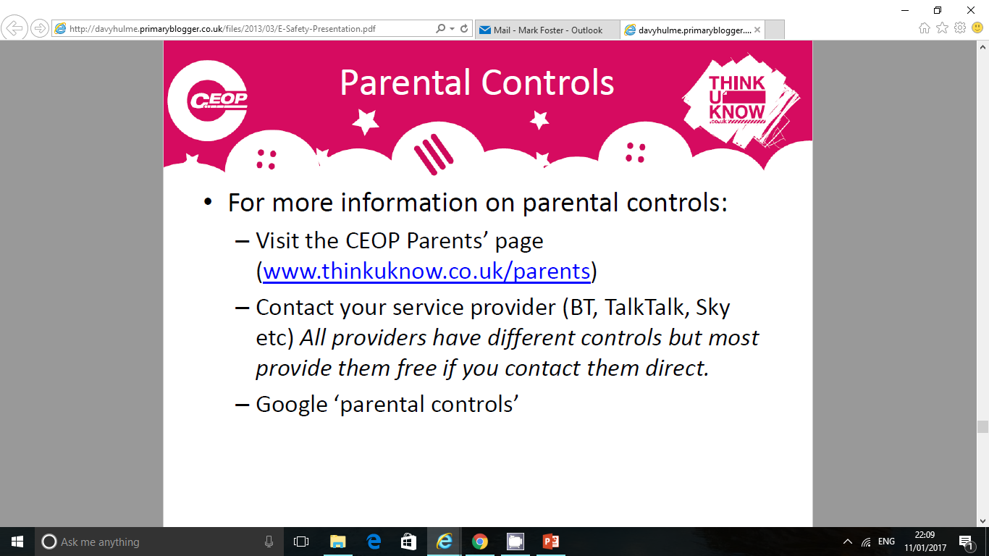
www.thinkuknow.co.uk/parents

Slide 21
Parental Controls
There is no ‘one size fits all’ for Parental Controls
Parental Controls can be set up on: Broadband, Games Consoles, Online/browser, Social Media/Apps, Paid options – apps/filtering software.
One option is to use a search engine, such as google, and search for your device and parental controls for information on how to set them up.
Youtube is another great resource with visual guides on how to set up parental controls.

Slide 22
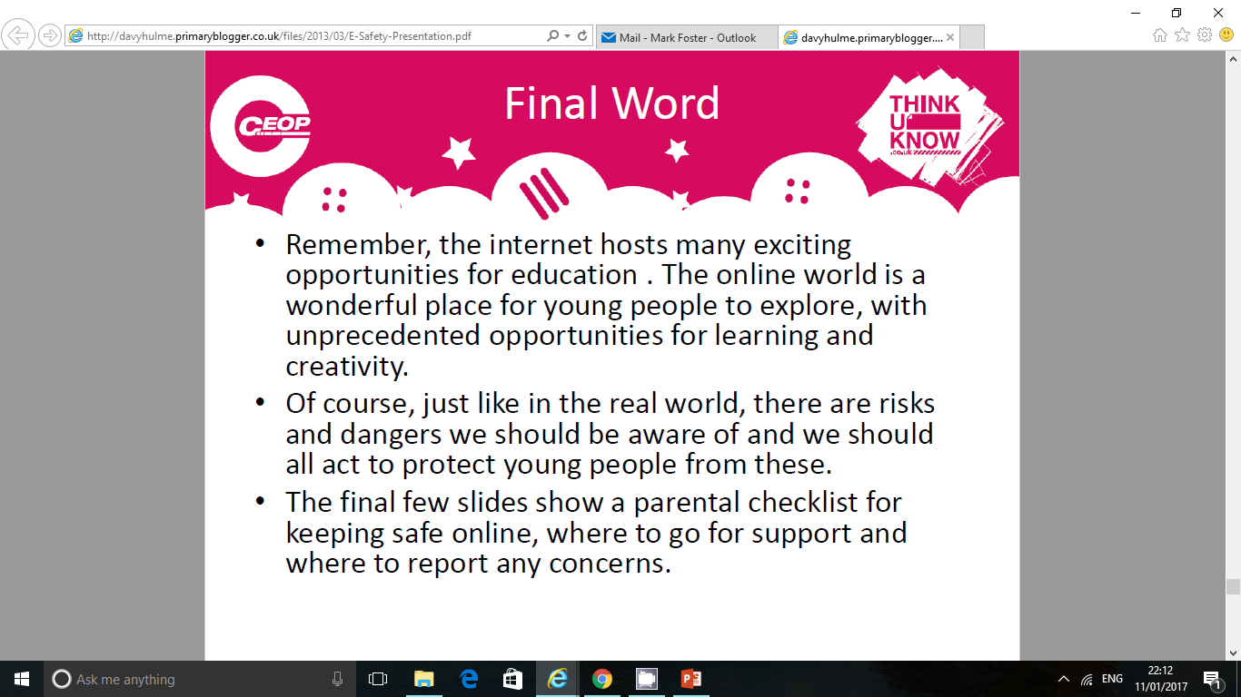

Slide 23
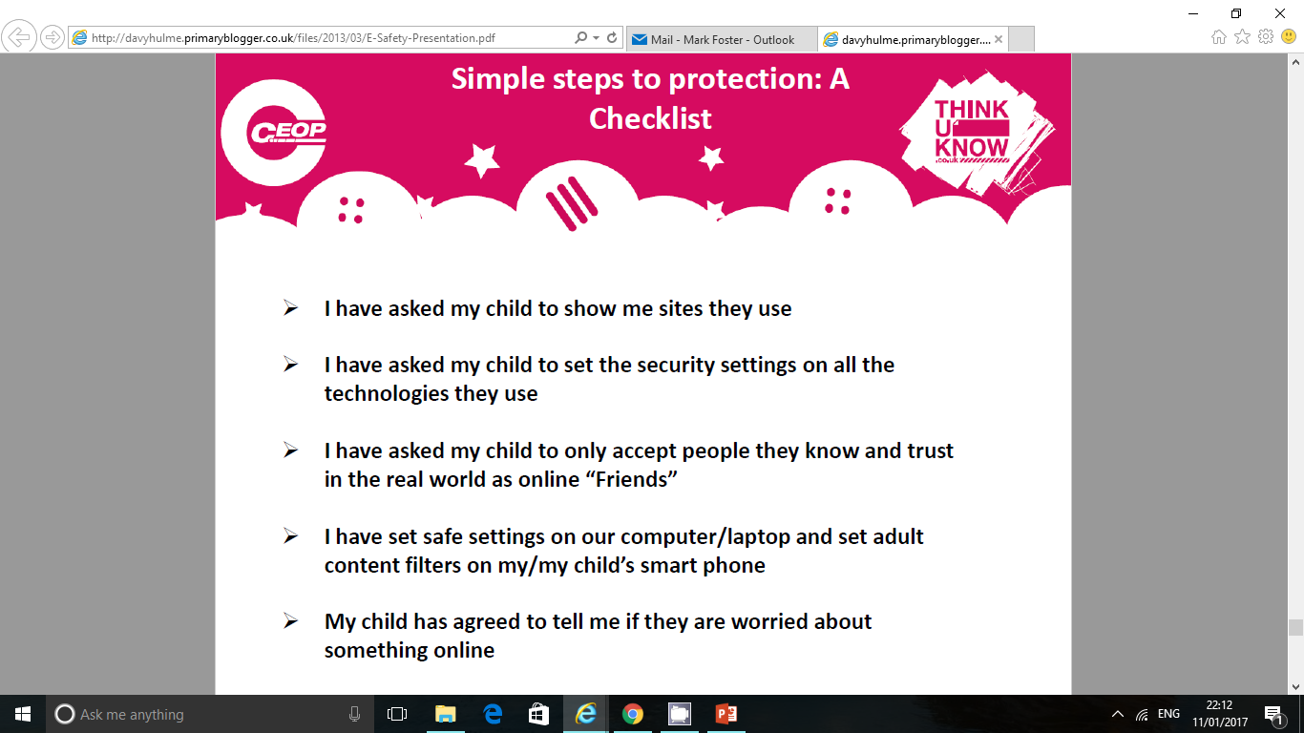

Slide 24
Useful Websites
•
Internet Safety:
www.thinkuknow.co.uk/parents
http://www.direct.gov.uk/en/Parents/Yourchildshealthandsafety/Internetsafety/index.htm
http://www.iwf.org.uk/
Facebook
http://www.facebook.com/safety/

